Slide 1
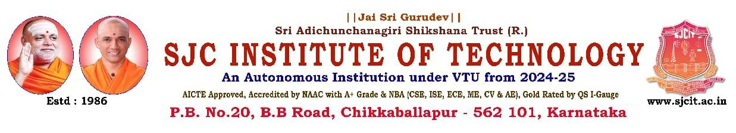
“Low-Light Image Enhancement and Denoising Using Deep Learning Techniques”
PRESENTED BY
1 Ajaganna 1SJ22CS006
2 Akash 1SJ22CS007
3 Akshay M S 1SJ22CS008
4 Bhargav V 1SJ22CS024
UNDER THE GUIDANCE OF
Dr Seshaiah M
Associate professor, Department of CSE

Slide 2
CONTENTS
Abstract
Introduction
Literature Survey (comparison with existing system)
Problem identification and definition
Significance and relevance of work
Objectives and methodology
Plan of execution
SRS (System requirements specification)
System analysis and System Design
implementation
Testing
Results and discussion
Conclusion and future enhancements

Slide 3
ABSTRACT
Low-light conditions significantly degrade image quality, affecting applications such as surveillance, photography, and autonomous systems. To address this challenge, this project presents a hybrid solution that combines DEDUNet, a deep learning model for brightness enhancement and noise reduction, with advanced image processing techniques such as gamma correction, CLAHE, selective enhancement, and color grading. Furthermore, a web-based interactive interface has been developed, providing advanced color controls, real-time quality metrics (PSNR, SSIM, and Enhancement Score), and user feedback through a 5-star rating system.

Slide 4
INTRODUCTION
Low-light images often suffer from poor brightness, high noise, and loss of details, making it difficult for both humans and computer systems to understand them.
Traditional image enhancement methods can increase brightness, but they usually distort colors or exaggerate noise, resulting in unnatural outputs.
Deep learning techniques improve illumination more intelligently, but they may smooth out fine textures or offer limited control to the user.
To overcome these limitations, our project uses a hybrid enhancement approach that combines the strengths of AI-based models with classical image processing methods.
This integrated design helps produce images that are clear, natural-looking, and noise-free, while also being efficient enough for real-time applications.

Slide 5
Literature Survey
Sl. No. | Title & Year of Publication | Methodology Used | Limitations
1 | Low-Light Image Enhancement by Principal Component Analysis (2018) | PCA-based enhancement using feature projection to improve brightness and contrast | Lacks adaptive learning and fails in preserving texture under complex lighting
2 | Single-Stage Unsupervised Denoising Low-Illumination Enhancement using Swin Transformer (2023) | Swin Transformer-based unsupervised model for enhancement and denoising without paired training data | High computational cost, limiting real-time edge deployment
3 | Cross-Image Disentanglement for Low-Light Enhancement in Real World (2022) | Disentangling illumination and content features via unpaired learning | Requires complex training and fine-tuning for effective generalization
4 | DEDU: Dual-Enhancing Dense-UNet for Lowlight Image Enhancement and Denoise (2024) | Dual-pathway Dense UNet separating structure and detail features for robust enhancement | Higher model complexity and increased training time

Slide 6
Literature Survey
Sl. No. | Title & Year of Publication | Methodology Used | Limitations
5 | DLDiff: Image Detail-Guided Latent Diffusion Model for Low-Light Image Enhancement (2023) | Uses latent diffusion guided by image details to enhance low-light images progressively | Computationally expensive; slower inference makes it less suitable for real-time use
6 | Ghost Imaging in the Dark: A Multi-Illumination Estimation Network for Low-Light Image Enhancement (2023) | Employs ghost imaging principles and multiple illumination estimations to enhance scene visibility | May introduce latency and perform poorly in extremely low-light or noisy conditions
7 | Self-Supervision via Controlled Transformation and Unpaired Self-Conditioning for Low-Light Image Enhancement (2023) | Trains the model without paired data using controlled transformations and self-conditioning | Might be less effective in highly diverse real-world settings without additional fine-tuning
8 | LRT: An Efficient Low-Light Restoration Transformer for Dark Light Field Images (2023) | Applies Transformer-based restoration specifically for dark light field images using attention mechanisms | Demands high GPU memory and compute power, making it impractical for deployment on low-resource devices

Slide 7
PROBLEM IDENTIFICATION & DEFINITION
Problem
Low-light images contain:
Underexposure
High noise levels
Color distortion
Loss of fine textures
Existing solutions either:
Over-enhance,
Produce artifacts, or
Fail in real-time applications.
Definition
Developed a hybrid low-light enhancement framework that improves brightness, removes noise, preserves details, and works efficiently.

Slide 8
SIGNIFICANCE & RELEVANCE OF WORK
Enhances images for photography, CCTV surveillance, medical imaging, autonomous systems.
Ensures natural-looking outputs where both brightness and details are balanced.
Combines strengths of AI and classical methods—making it robust, flexible, and user-friendly.
Enables real-time deployment through optimized processing.

Slide 9
OBJECTIVES AND METHODOLOGY
Objectives
Improve visibility and illumination in low-light images.
Reduce noise while preserving texture and fine details.
Maintain natural colors and sharp edges.
Develop a simple web application for real-time enhancement.
Evaluate performance using PSNR, SSIM, and runtime.
Methodology
Use DEDUNet for global illumination enhancement and denoising.
Apply mask-guided correction to selectively improve darker regions.
Add classical refinement methods:
-CLAHE
-Gamma correction
-Histogram equalization
-Bilateral filtering / Non-Local Means
Integrate all steps into a hybrid enhancement pipeline.
Deploy the system as a web-based application with real-time preview and output evaluation.

Slide 10
PLAN OF EXECUTION
GANTT CHART – 12 WEEK PROJECT PLAN
Task W1 W2 W3 W4 W5 W6 W7 W8 W9 W10 W11 W12
--------------------------------------------------------------------------------------------------------------------------------------
Literature Review ███ ███
Problem Definition & Scope ███
Dataset Collection & Preprocessing ███ ███
SRS & System Design ███ ███
AI Model Development (DEDUNet) ███ ███
Training & Model Tuning ███
Classical Enhancement (CLAHE, Gamma, Filters) ███ ███
Hybrid Pipeline Finalization ███
Web App UI & Backend Integration ███ ███
Performance Optimization & Metrics ███
Testing (Functional + Comparative) ███
Results, Documentation, Final Presentation ███

Slide 11
SRS (System Requirements Specification)
Functional Requirements:
Upload image and apply enhancement (DEDUNet + traditional).
Provide color controls (brightness, contrast, saturation, hue, temperature, shadows/highlights).
Show real-time quality metrics (PSNR, SSIM, enhancement score, processing time).
Collect user ratings via 5-star feedback.
Non-Functional Requirements:
Performance: <1s processing per image.
Usability: Web-based interface with sliders and previews.
Compatibility: Supports multiple image formats (PNG, JPG, BMP, TIFF).
Software Requirements:
Python, PyTorch, OpenCV, Flask, NumPy, PIL, skimage.
Hardware Requirements:
GPU-enabled system for model inference (optional).
Minimum 8GB RAM, 2.5 GHz CPU.

Slide 12
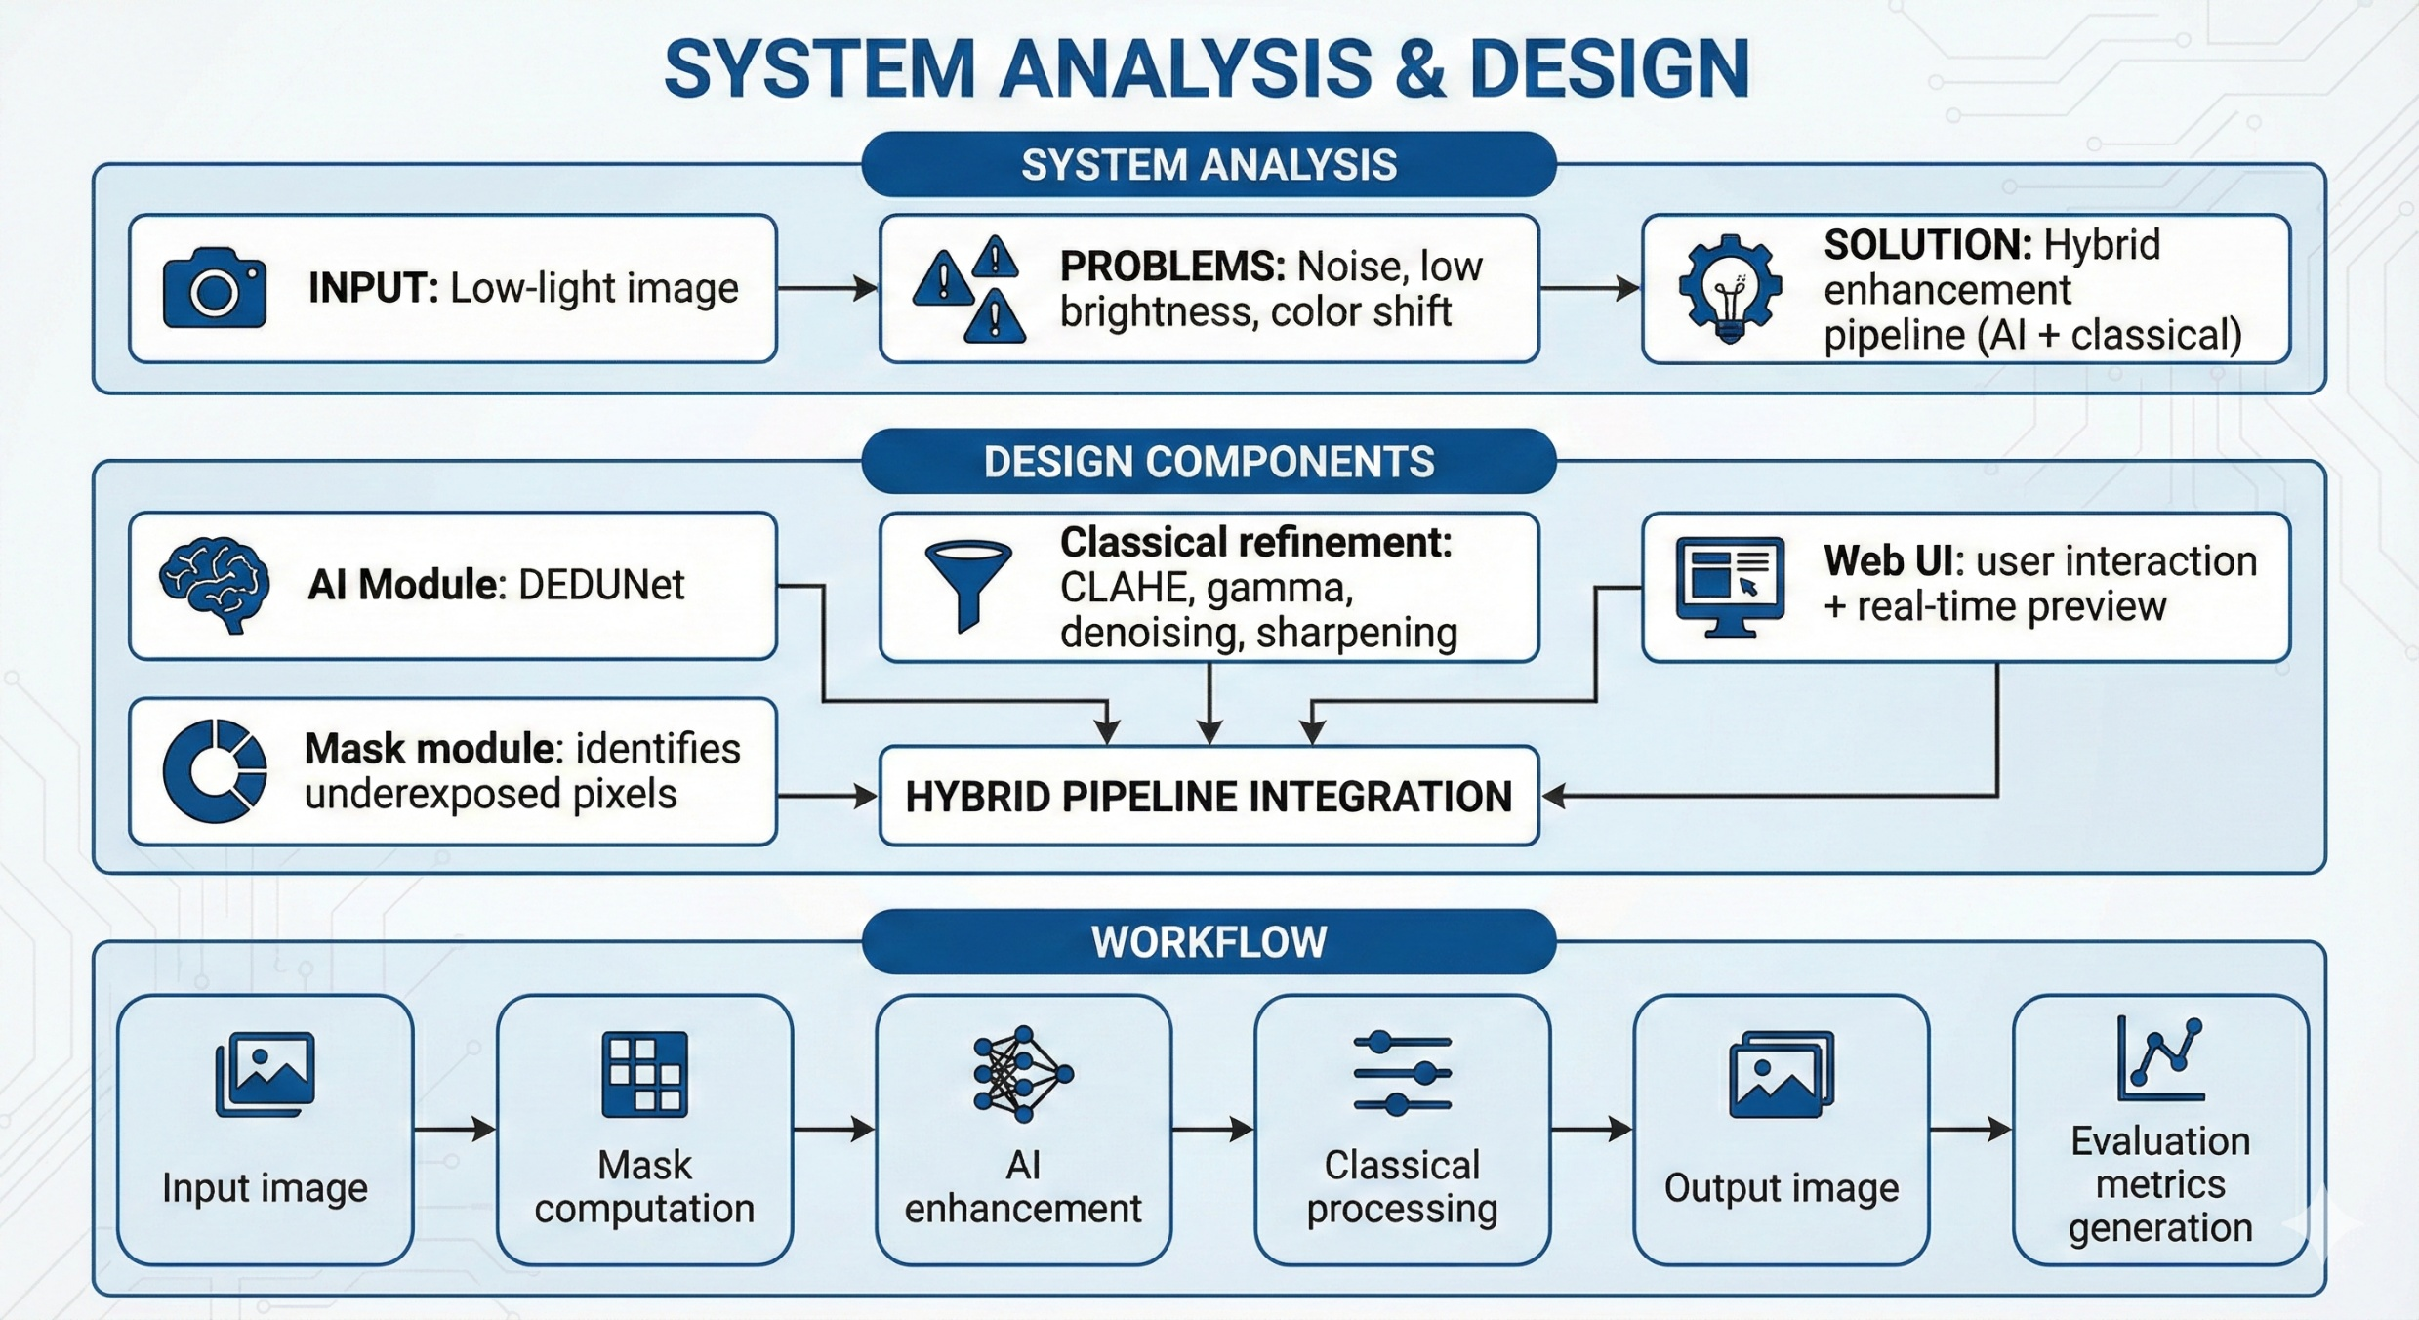

Slide 13
IMPLEMENTATION
DEDUNet implemented with dense skip connections and attention blocks.
Mask-guided enhancement applied to dark areas only.
Classical processing integrated as user-adjustable modules.
Web app created using Flask/Streamlit showing real-time results.
Metrics computed automatically after enhancement.

Slide 14
TESTING
Testing Types
Functional Testing: upload, enhance, download
Performance Testing: runtime on CPU/GPU
Quality Evaluation: PSNR, SSIM
Visual testing: comparison with CLAHE, Retinex, Zero-DCE, DEDUNet
Dataset-based Testing
LOL, SID, SICE datasets used for benchmarking.
Observations
Proposed method achieves PSNR = 23.1 dB and SSIM = 0.87, outperforming other methods

Slide 15
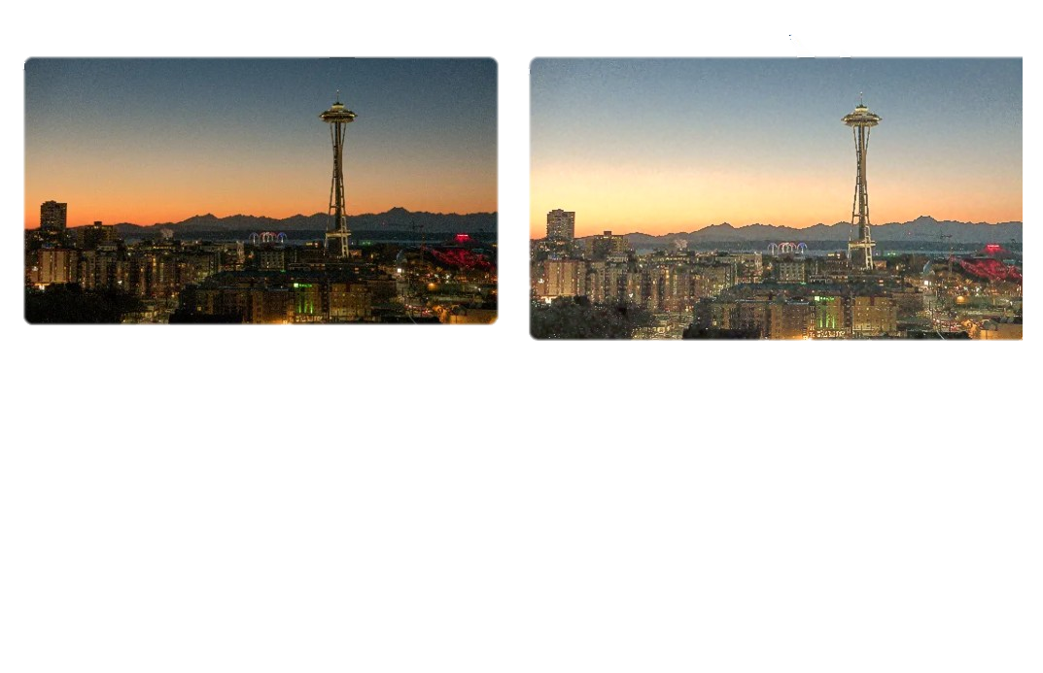
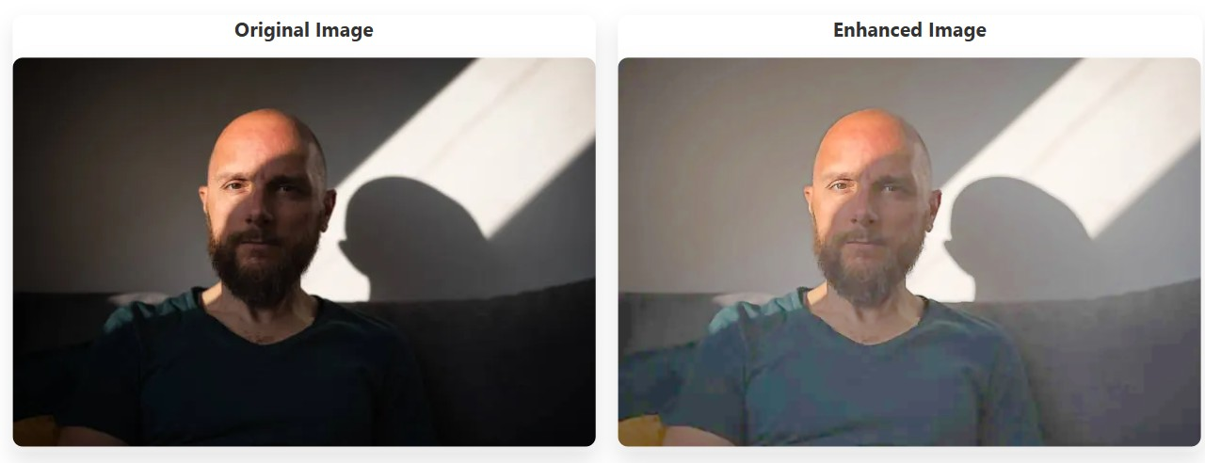
Results Obtained
Sample low-light image enhanced → brighter, less noisy, improved details (see below examples).
Quality Metrics Example:
PSNR ↑ from ~18 dB → ~32 dB.
SSIM ↑ from ~0.62 → ~0.91.
Enhancement Score ~85%.
Real-time processing under 1s per image
(on GPU).
User study: Higher satisfaction with
advanced color grading + feedback loop.

Slide 16
CONCLUSION & FUTURE ENHANCEMENTS
Conclusion
A hybrid low-light image enhancement framework was built that:
Restores illumination
Removes noise
Preserves details
Achieves real-time performance
Outperforms existing classical and deep-learning approaches.
Future Enhancements
Optimize model for mobile devices.
Incorporate larger and more diverse datasets.
Add intelligent modules for adaptive brightness control.
Explore diffusion models and transformers for even better realism.
Extend system to include super-resolution & segmentation.

Slide 17
THANK YOU

